Slide 1

Presentation - HRS4R -
- HRS4R -
Human Resources Strategy
for Researchers

Slide 2
Presentation - HRS4R -
INTRODUCTION
PROCESS PHASES
3. ACTION CALENDAR 2023

Slide 3
Presentation - HRS4R -
INTRODUCTION
    The European Charter for Researchers
    The Code of Conduct for the Recruitment of Researchers
(40 principles of the Charter&Code)
https://www.euraxess.es/spain/services/human-resources-strategy-researchers-hrs4r

Slide 4
Presentation - HRS4R -
European Charter for Researchers:
Set of general principles and requirements which specifies the roles, responsibilities and entitlements of researchers as well as of employers and funding bodies of researchers.
It constitutes a framework for researchers, employers and funders which invites them to act responsibly and to recognize each other as professionals.
INSTITUTIONS (19)
Recognition of the profession
Non discrimination
Research environment (safety & others)
Stability and permanence of employment
Funding & salaries
Career development strategy
Research training and continuous development
Evaluation & appraisal
Participation in decision making bodies
…
RESEARCHERS (12)
Research freedom
Ethical principles of the discipline
Professional responsibility and attitude
Accountable to funders and society
Dissemination of results to the public
Continuous professional development
…..

Slide 5
Presentation - HRS4R -
Code of Conduct for the Recruitment of Researchers
Set of general principles and requirements that should be followed by employers when appointing and recruiting researchers.
Complementary to the European Charter for Researchers.
Institutions will openly demonstrate their commitment to act in a responsible and respectable way and to provide fair working conditions to researchers, with a clear intention to contribute to the advancement of the European Research Area.
RECRUITMENT (9)
Open, efficient, transparent recruitment (OTM-R)
Selection committees: balanced (gender, public&private)
Transparency of criteria (before, during and after the selection)
Judging merit (not only publications!)
Open to variations in chronological orders of CV
Recognition of mobility experience
Recognition of qualifications
Seniority
Postdoctoral appointments

Slide 6


Presentation - HRS4R -
What tools/legal framework do we have?
https://www.euraxess.es/
ARTICLE 32 AT HORIZON 2020 MODEL GRANT AGREEMENT :
“Hiring and work conditions for researchers”: beneficiaries must take necessary measures in order to implement the principles of the Charter for Researchers and the Code of Conduct for the Recruitment of Researchers, the so-called Charter&Code.

Slide 7

Presentation - HRS4R -
Human Resources Strategy for Researchers – HRS4R –
EU project to support institutions in implementing the Charter&Code
It involves integrating the principles of the European Charter and Code into the heart of the HR policies of endorsing institutions.
It involves a long process, effort and commitment from different levels and internal work groups of the Center: Director, Management, HR and internal staff (participative).
This is not a logo of excellence.
It recognizes the institution's efforts in complying with C&C.
HR Excellence in Research award
HR Excellence in Research award

Slide 8
Presentation - HRS4R -
What objective has the CENIEH set itself?
  To endorse the Recommendation by the European Commission 2005/251 / CE of March 11th 2005 on the "European Charter for Researchers" and the "Code of Conduct for the Recruitment of Researchers" adopted by the European Commission.
  In its Strategic Plan 2021 2024, the objective of achieving the "HR Excellence in Research Award" has been set for the time horizon 2024.
  A series of actions were envisaged in the ANNUAL Plans 2022 and 2023

Slide 9
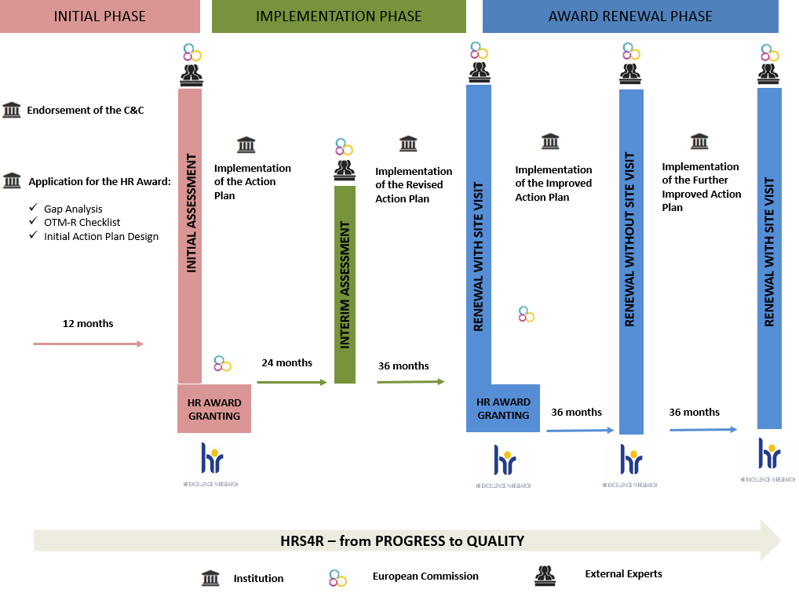
Presentation - HRS4R -
2. PROJECT PHASES:

Slide 10

Presentation - HRS4R -
2. PROCESS PHASES:
  Send letter of commitment
  Acknowledgment of the letter of commitment
  Application for the HR award:
    Gap Analysis (with regard to the principles of C&C: where you are and where you want to go.
    OTM-R (Open, transparent and merit-based recruitment of researchers).
    Initial Action Plan.
  Initial evaluation:
    Evaluation of the appropriateness of the application in administrative terms.
    External evaluation of the application by three experts.

Slide 11
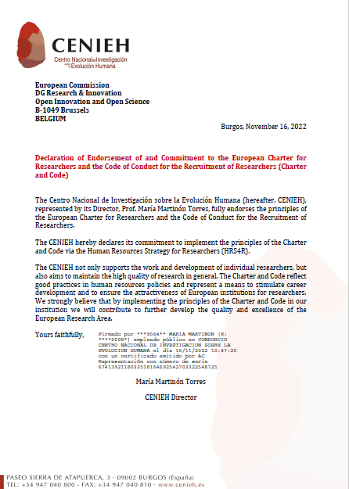
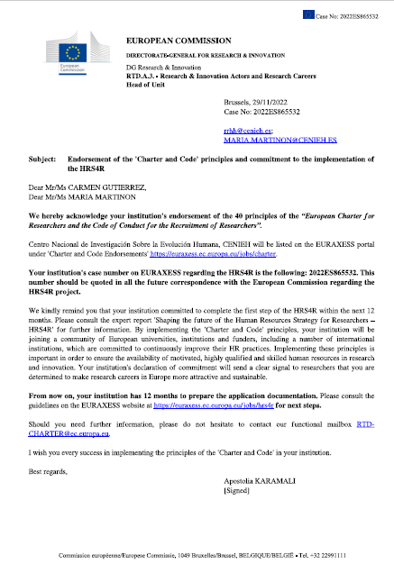
Presentation - HRS4R -
2. PROCESS PHASES:

Slide 12
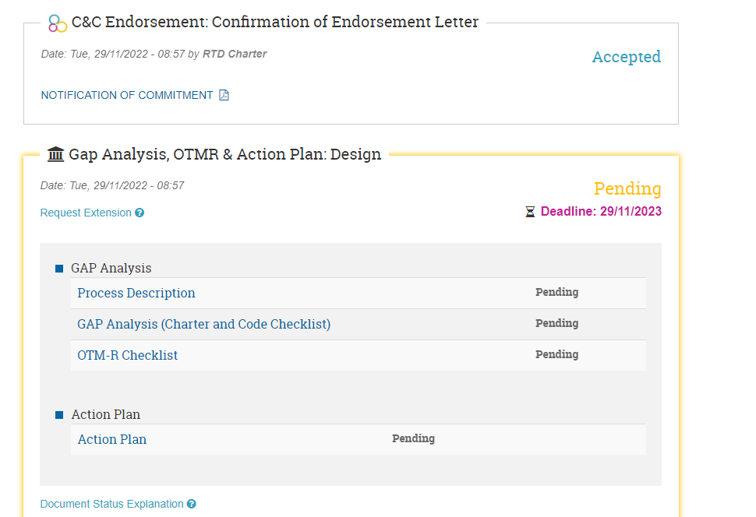
Presentation - HRS4R -
2. PROCESS PHASES:

Slide 13
Presentation - HRS4R -
2. PROCESS PHASES:
Send letter of commitment → November 16th 2022
Acknowledgment of the letter of commitment → November 29th 2022
Application for the HR award:
  Gap Analysis (with regard to the principles of C&C: where you are and where you want to go.
    Template 1 Process
    Template 2 Overview
  OTM-R (Open, transparent and merit-based recruitment of researchers). Template 3
  Initial Action Plan. Template 4
4. Initial evaluation:
  Evaluation of the appropriateness of the application in administrative terms.
  External evaluation of the application by three experts.

Slide 14


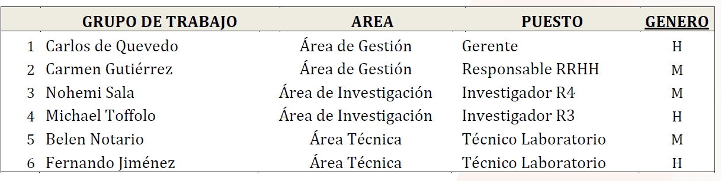
Presentation - HRS4R -
….AND THE WINNERS ARE…….

Slide 15
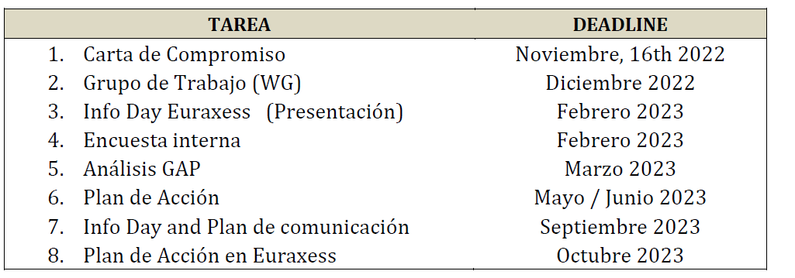
Presentation - HRS4R -
3. ACTION CALENDAR 2023

Slide 16
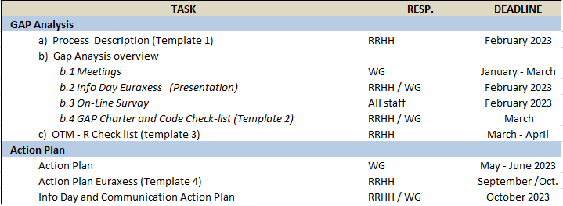
Presentation - HRS4R -
3. ACTION CALENDAR 2023

Slide 17
Presentation - HRS4R -
GAP ANALYSIS:
How the organization assesses the degree of compliance with the 40 principles of the Charter&Code.
What its deficiencies are, how these are to be solved, and identification of any obstacle to implementation.
The 40 principles are classified into 4 groups:
- Ethical & Professional Aspects
- Recruitment & Selection
- Working Conditions & Social Security
- Training & Development
The classification may be:
- Fully Implemented: in this case evidence such as programs, policies to be followed... should be indicated
- Almost but not fully implemented
- Partially implemented
- Insufficiently implemented
If it is not Fully Implemented, the deficiency and the measures to be taken to remedy this should be stated.

Slide 18
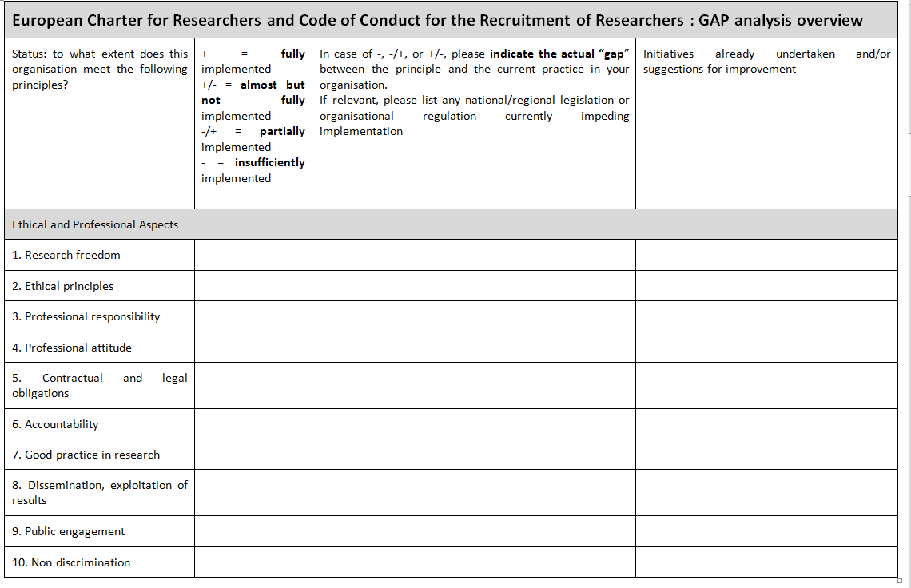
Presentation - HRS4R -
GAP ANALYSIS:

Slide 19
Presentation - HRS4R -
GAP ANALYSIS:
 | 2021 | M | W | 2022 | M | W
Researchers | 19 | 11 | 8 | 20 | 12 | 8
Research Fellows | 6 | 2 | 4 | 5 | 2 | 3
Laboratory Technicians | 19 | 6 | 13 | 20 | 8 | 12
Library | 0 | 0 | 0 | 0 | 0 | 0
Internal Relations - Communication | 2 | 0 | 2 | 2 | 0 | 2
Management | 12 | 4 | 8 | 16 | 5 | 11
TOTAL STAFF | 58 | 23 | 35 | 63 | 27 | 36
 |  | 40% | 60% |  | 43% | 57%

Slide 20


Presentation of Implementation – HRS4R –
For the next meeting (to be arranged soon) :
Read the C&C closely
Read the GAP Template
Read the European Research Career Framework
I will present a draft of the “survey”
BUT…….THERE'LL BE A PRIZE!

Slide 21

Presentation of Implementation – HRS4R –
MANY THANKS TO YOU ALL!!

